Slide 1
Convolutional layers optimization (Work in progress)
Jakob Kruse (IFAG DES SDF SCS SEM)
28.05.2020

Slide 2
Conv Layer

Slide 3
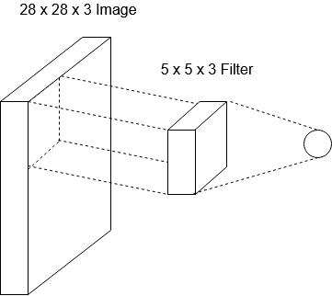
Convolutional layers
equal
Input_x
Input_y
Input_c
filter_x
Input_c
filter_y
One output neuron
Convolve the filter with the image using dot product

Slide 4
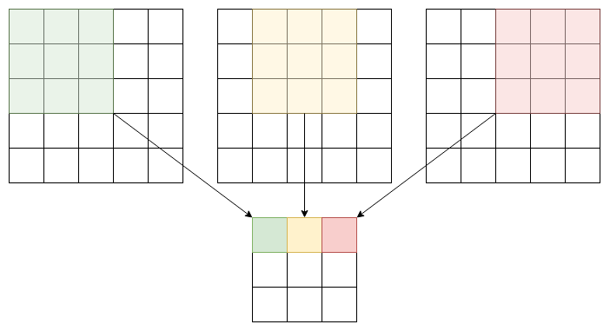
Convolutional layers
Input
Input_x * Input_y * Input_c
Output
Out_x * Out_y * 1
Out_x = (Input_x – Filter_x + 1) / stride
Out_y = (Input_y – Filter_y + 1) / stride

Slide 5
Convolutional layers
Input
Input_x * Input_y * Input_c
Output
Multiple Filters (n filters)
Out_x * Out_y * n
Out_x = (Input_x – Filter_x + 1) / stride
Out_y = (Input_y – Filter_y + 1) / stride
Batches not mentioned yet

Slide 6
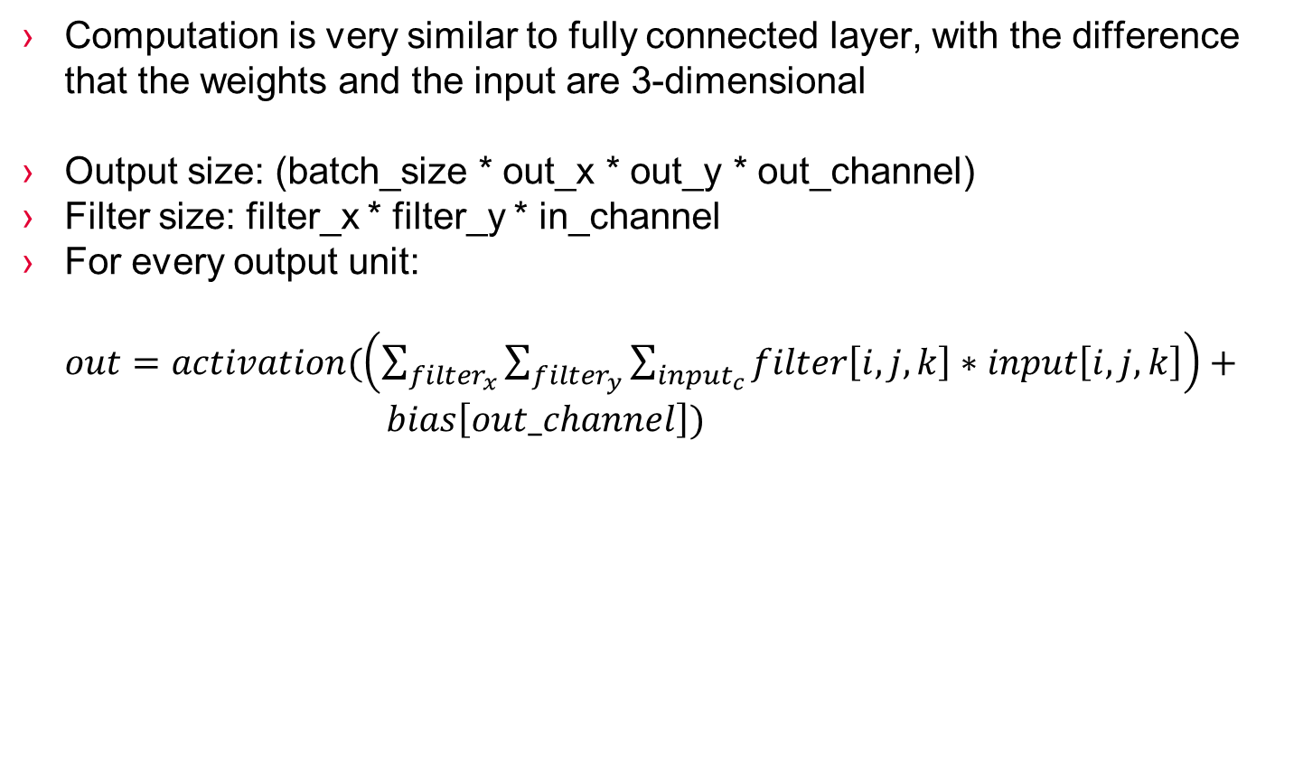
FLOAT Convolutional layer calculations
Computation is very similar to fully connected layer, with the difference that the weights and the input are 3-dimensional
Output size: (batch_size * out_x * out_y * out_channel)
Filter size: filter_x * filter_y * in_channel
For every output unit:
$out=activation(\left(\sum_{filter_{x}}{\sum_{filter_{y}}{\sum_{input_{c}}{filter\left[i,j,k\right]∗input\left[i,j,k\right]}}}\right)+ bias\left[out_channel\right])$

Slide 7
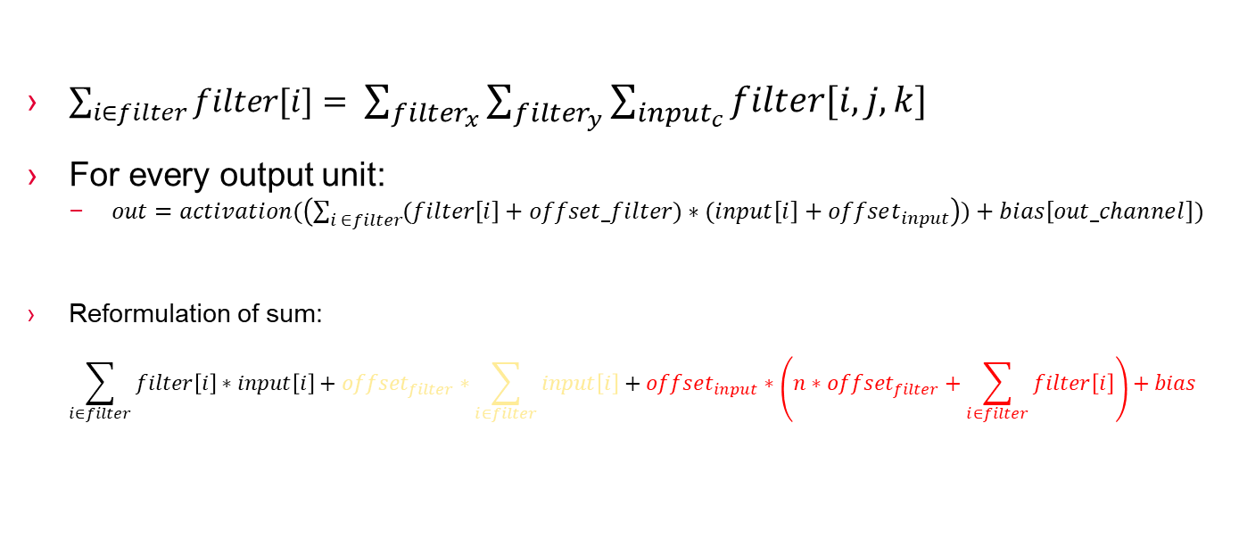
UINT8 Convolutional layer calculations
$\sum_{i∈filter}{filter[i]}= \sum_{filter_{x}}{\sum_{filter_{y}}{\sum_{input_{c}}{filter\left[i,j,k\right]}}}$
For every output unit:
$out=activation(\left(\sum_{i ∈filter}{(filter\left[i\right]+offset_filter)∗(input\left[i\right]+offset_{input}}\right))+bias\left[out_channel\right])$
Reformulation of sum:
$$\sum_{i∈filter}{filter\left[i\right]∗input\left[i\right]+offset_{filter}∗\sum_{i∈filter}{input\left[i\right]}+offset_{input}∗\left(n∗offset_{filter}+\sum_{i∈filter}{filter\left[i\right]}\right)+bias}$$
New-input-factor
Must be calculated every time
Sum-of-input-factor
Used multiple times (n=out_channel)
Should only be computed once
Not worth optimizing
Sum-of-filter-factor (with bias)
Always the same (can be precomputed)
Memory requirement: out_channel * int32
Finally, apply ouput shift, multiplier and offset and store value

Slide 8
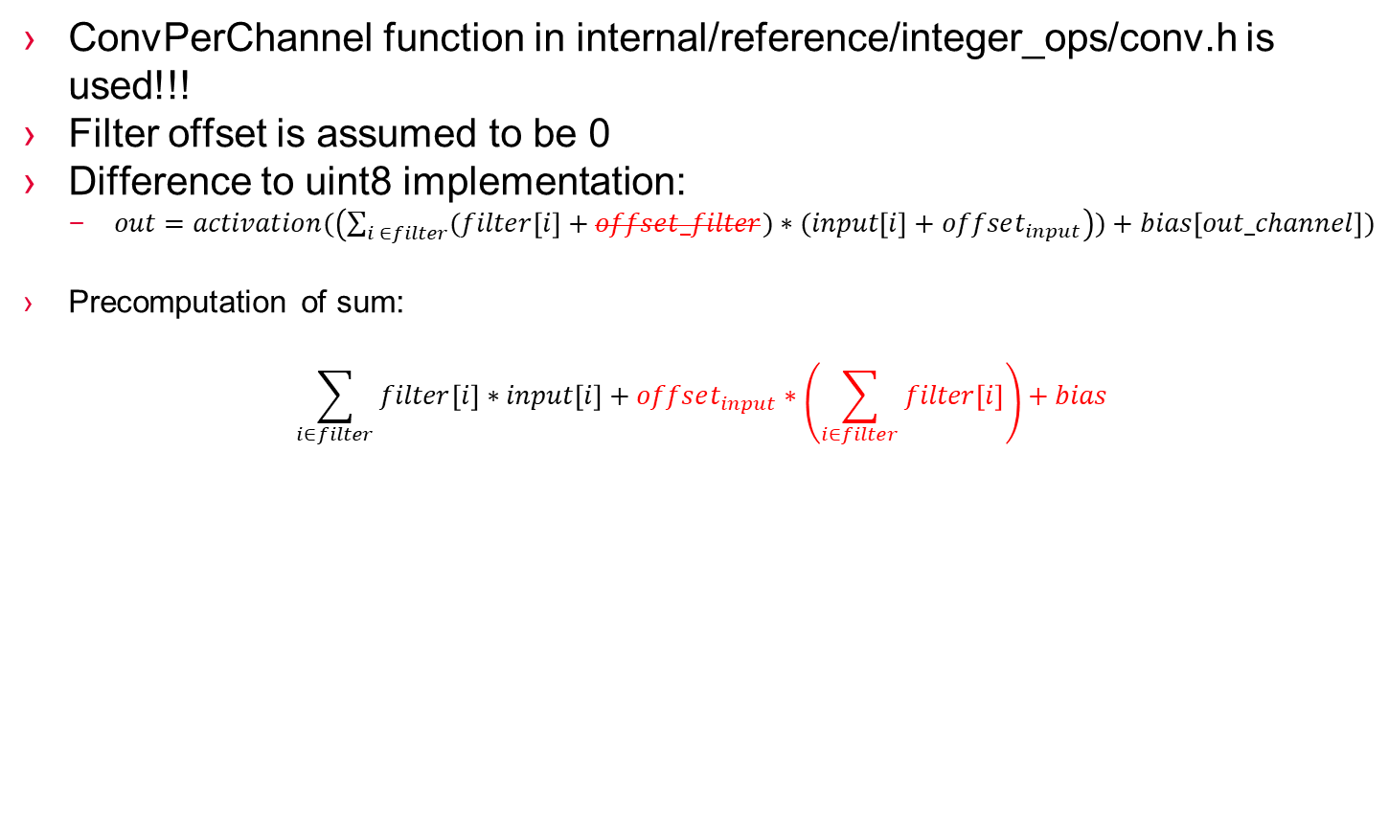
INT8 Convolutional layer calculations
ConvPerChannel function in internal/reference/integer_ops/conv.h is used!!!
Filter offset is assumed to be 0
Difference to uint8 implementation:
$out=activation(\left(\sum_{i ∈filter}{(filter\left[i\right]+offset_filter)∗(input\left[i\right]+offset_{input}}\right))+bias\left[out_channel\right])$
Precomputation of sum:
$$\sum_{i∈filter}{filter\left[i\right]∗input\left[i\right]+offset_{input}∗\left(\sum_{i∈filter}{filter\left[i\right]}\right)+bias}$$
New-input-factor
Must be calculated every time
Sum-of-filter-factor (with bias)
Always the same (can be precomputed)
Memory requirement: out_channel * int32

Slide 9
All optimizations I made
Dynamic memory allocation of OpData members
Moved CalculateOpData function call to Prepare phase
Precomputation of Sum-of-filters Factor
Precomputation of Sum-of-inputs Factor (not worth)
Loop variable optimization
Using filter consecutivity
Removing conditional statements
Causes problems if dilation factor is not 1
→ If dilation factor is not one, reference implementation is used
If padding != 0, the precomputation and filter consecutivity can‘t be used!
Extra implementation in this case
I added 2 extra tensorflow tests for padding (there were none)

Slide 10
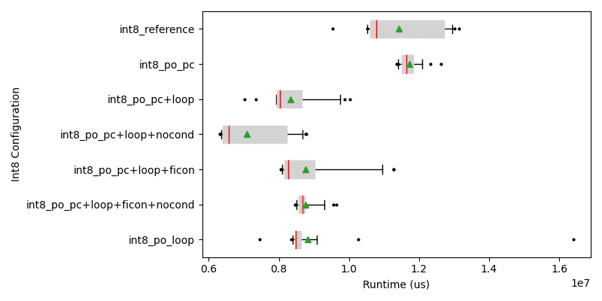
Benchmarks Int8
On host computer
PO: Portable optimized
Optimizations:
Precomputations(PC)
Loop Variables(Loop)
Filter consecutivity(Ficon)
Remove Conditionals (nocond)

Slide 11
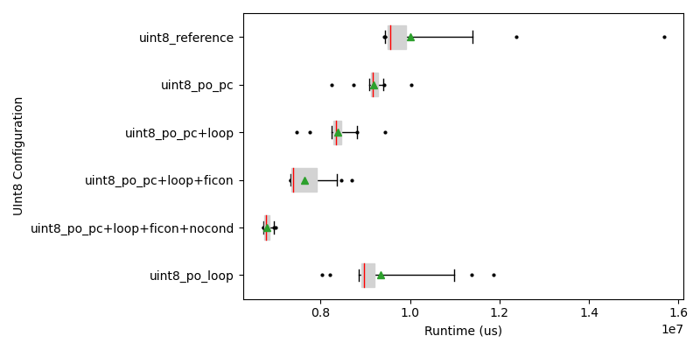
Benchmarks UInt8
On host computer
PO: Portable optimized
Optimizations:
Precomputations(PC)
Loop Variables(Loop)
Filter consecutivity(Ficon)
Remove Conditionals (nocond)

Slide 12
Benchmarks RISC V
UInt8 | Reference | Port. Optimized
Avg Time | 3278 | 974
Int8 | Reference | Port. Optimized
Avg Time | 3602 | 1020
With Padding (different values as above):
UInt8 | Reference | Port. Optimized
Avg Time | 3006 | 1229
Int8 | Reference | Port. Optimized
Avg Time | 3364 | 1089

Slide 13
Depthwise Conv Layer (WIP)

Slide 14
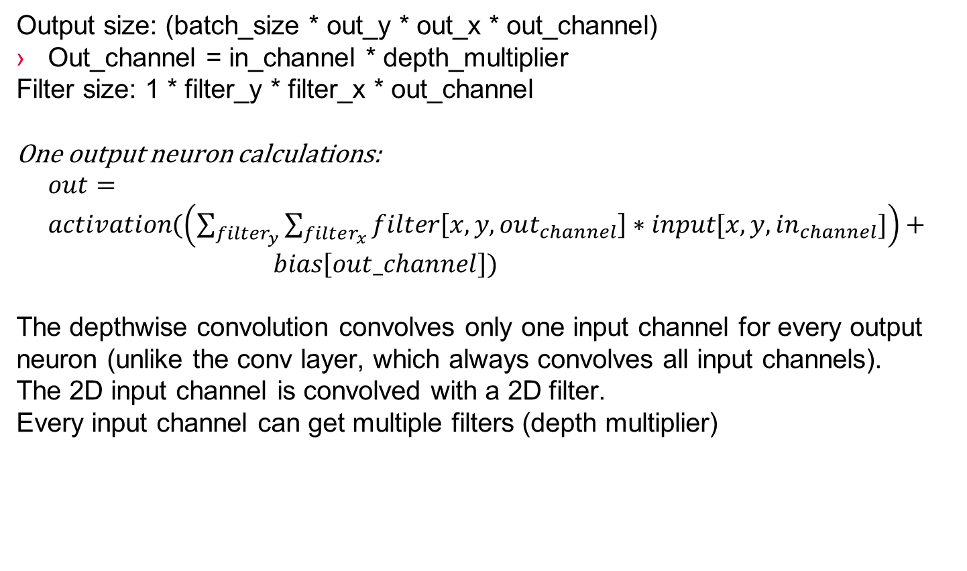
FLOAT Depthwise Conv layer calculations
Output size: (batch_size * out_y * out_x * out_channel)
Out_channel = in_channel * depth_multiplier
Filter size: 1 * filter_y * filter_x * out_channel
One output neuron calculations:
$out=activation(\left(\sum_{filter_{y}}{\sum_{filter_{x}}{filter\left[x,y,out_{channel}\right]∗input[x,y,in_{channel}]}}\right)+ bias\left[out_channel\right])$
The depthwise convolution convolves only one input channel for every output neuron (unlike the conv layer, which always convolves all input channels).
The 2D input channel is convolved with a 2D filter.
Every input channel can get multiple filters (depth multiplier)

Slide 15
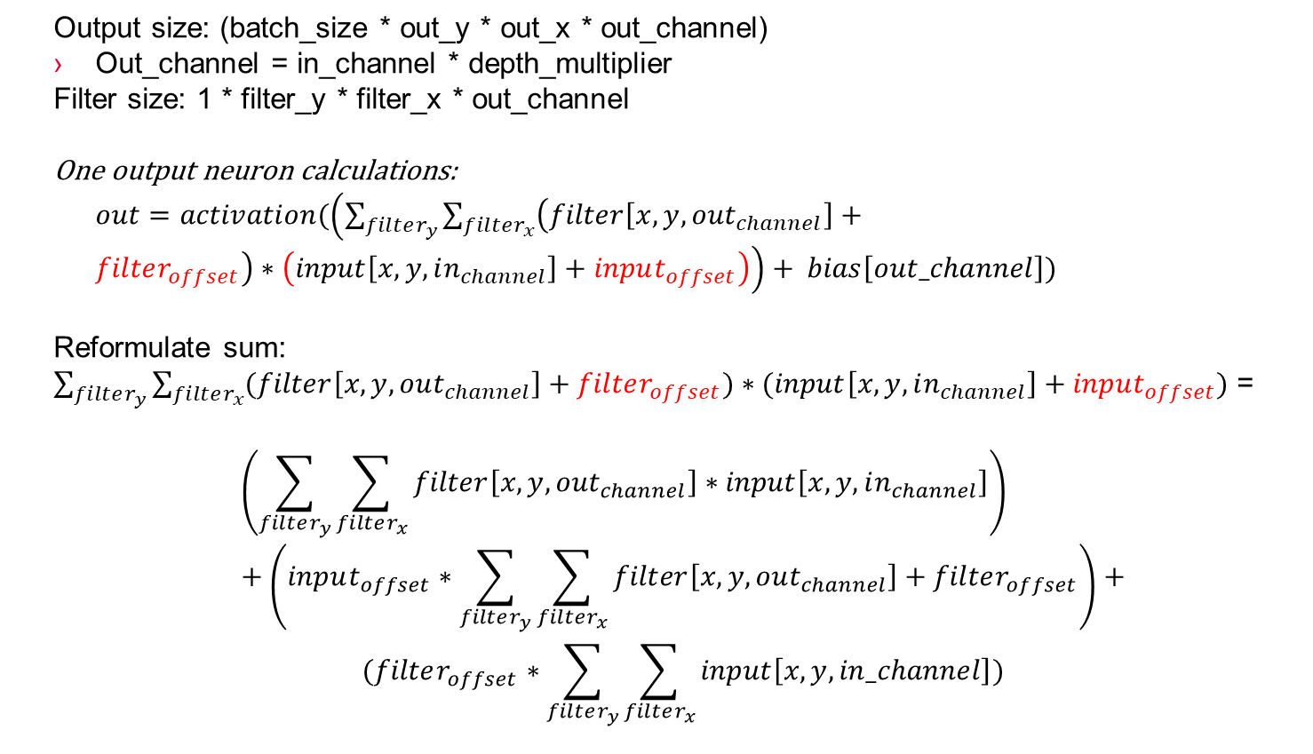
UInt8 Depthwise Conv layer calculations
Output size: (batch_size * out_y * out_x * out_channel)
Out_channel = in_channel * depth_multiplier
Filter size: 1 * filter_y * filter_x * out_channel
One output neuron calculations:
$out=activation(\left(\sum_{filter_{y}}{\sum_{filter_{x}}{\left(filter\left[x,y,out_{channel}\right]+filter_{offset}\right)∗\left(input\left[x,y,in_{channel}\right]+input_{offset}\right)}}\right)+ bias\left[out_channel\right])$
Reformulate sum:
$\sum_{filter_{y}}{\sum_{filter_{x}}{(filter\left[x,y,out_{channel}\right]+filter_{offset})∗(input\left[x,y,in_{channel}\right]+input_{offset})}}$ =
$$\left(\sum_{filter_{y}}{\sum_{filter_{x}}{filter\left[x,y,out_{channel}\right]∗input\left[x,y,in_{channel}\right]}}\right)+\left(input_{offset}∗\sum_{filter_{y}}{\sum_{filter_{x}}{filter\left[x,y,out_{channel}\right]+filter_{offset}}}\right)+$$
$$(filter_{offset}∗\sum_{filter_{y}}{\sum_{filter_{x}}{input\left[x,y,in_channel\right]}})$$

Slide 16
All optimizations I made
Loop variable optimization
Removing conditional statements
Causes problems if dilation factor is not 1
→ If dilation factor is not one, reference implementation is used
Precomputation of Sum-of-filters Factor
If padding != 0, the precomputation can‘t be used!
Extra implementation in this case
I added 2 extra tensorflow tests for padding (there were none)

Slide 17
Benchmarks RISC V
Data Type | Padding |  | Reference Time | Optimized Time
UInt8 | No |  | 1122 | 704
UInt8 | Yes |  | 1598 | 1039
UInt8 | No | SPECIAL | 1145 | 308
Int8 | No |  | 1221 | 611
Int8 | Yes |  | 1551 | 884
SPECIAL: Special Implementation for case:
Filter width == 8
Input offet == 0
Input depth == 1

